Slide 1

Car Infographic
AiPPT
Car Infographic
CFA
-134 for last month
Visual car data in infographics presents complex automotive information
SDY
-134 for last month
80%
MLB
-134 for last month
2.345 +
BST
-134 for last month
100k
50k
0k
20XX
20XX
20XX
20XX
20XX

Slide 2
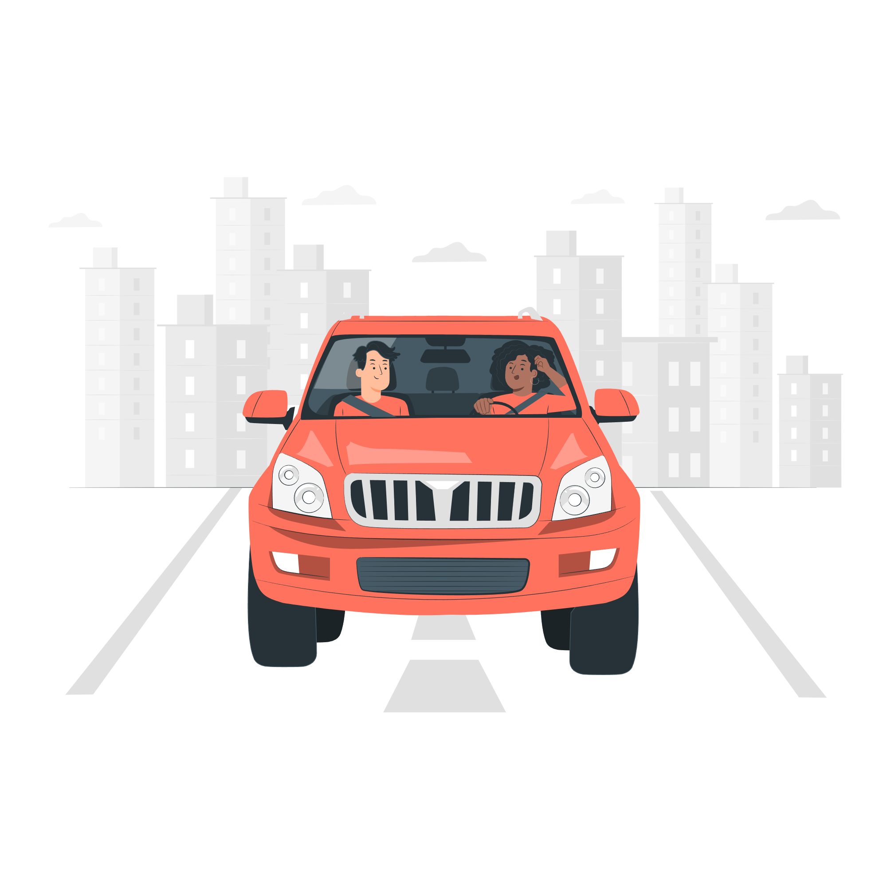
Car Infographic
AiPPT
Information presentation
Information presentation in car infographics aims to convey key details about vehicles, such as features and performance, in an easy - to - understand way.
Audience engagement is achieved through car infographics by using appealing visuals to capture viewers' attention and keep them interested in the car - related data.

Slide 3

Car Infographic
AiPPT
Car Infographic
Car Infographic
Car Infographic
2024
Car infographics serve as a decision - making aid, helping consumers compare different models and make informed choices based on presented data.
As a market analysis tool, car infographics help industry professionals understand market trends, consumer preferences, and competitive landscapes.

Slide 4
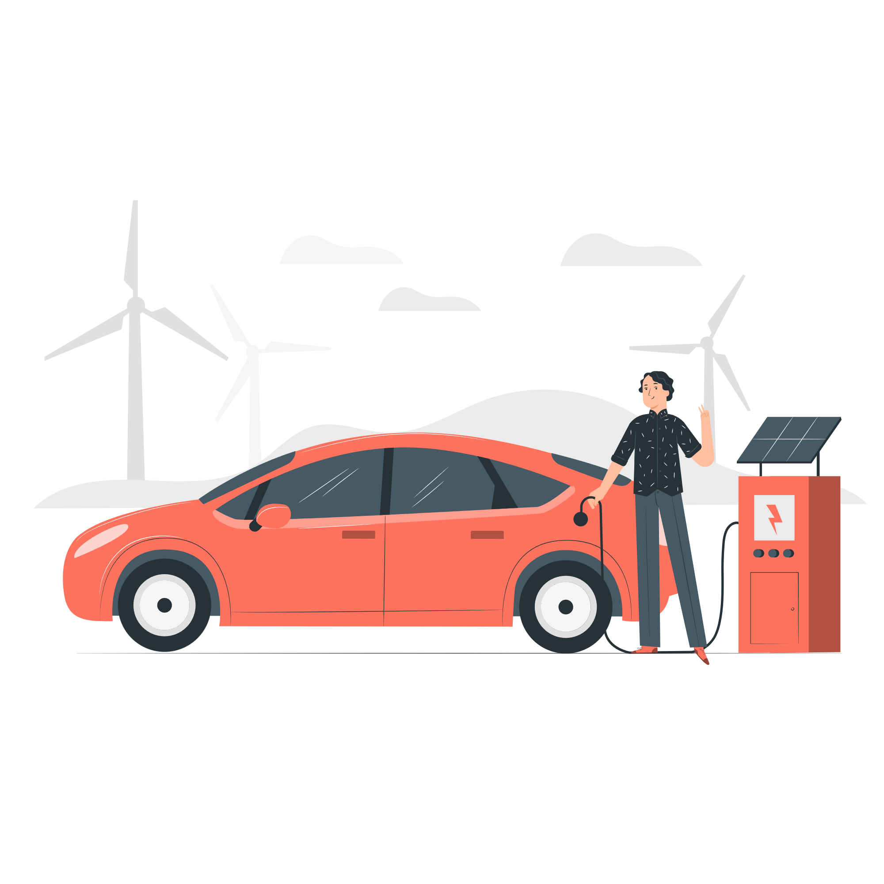
Car Infographic
AiPPT
Product promotion
Consumer education
TITLE 01
Car infographics play a crucial role in consumer education, providing detailed information about vehicle features, safety, and performance.
Market analysis tool
234 +
123 +
03 : 46 : 29 : 03
Trend identification
Competitor comparison

Slide 5

Car Infographic
AiPPT
TITLE 01
Detail Data
Manufacturer specs
TITLE 02
Consumer surveys
TITLE 03
Technical databases

Slide 6
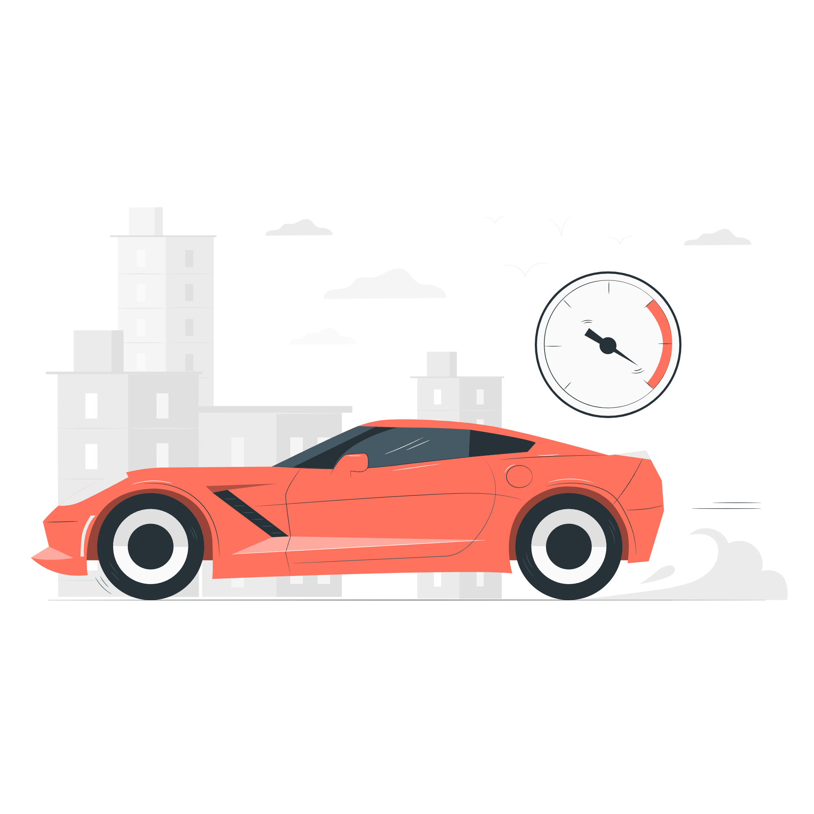
Car Infographic
AiPPT
Market research
Market research offers insights into consumer preferences, market trends, and competitor analysis. It helps in creating relevant and appealing car infographics.

Slide 7
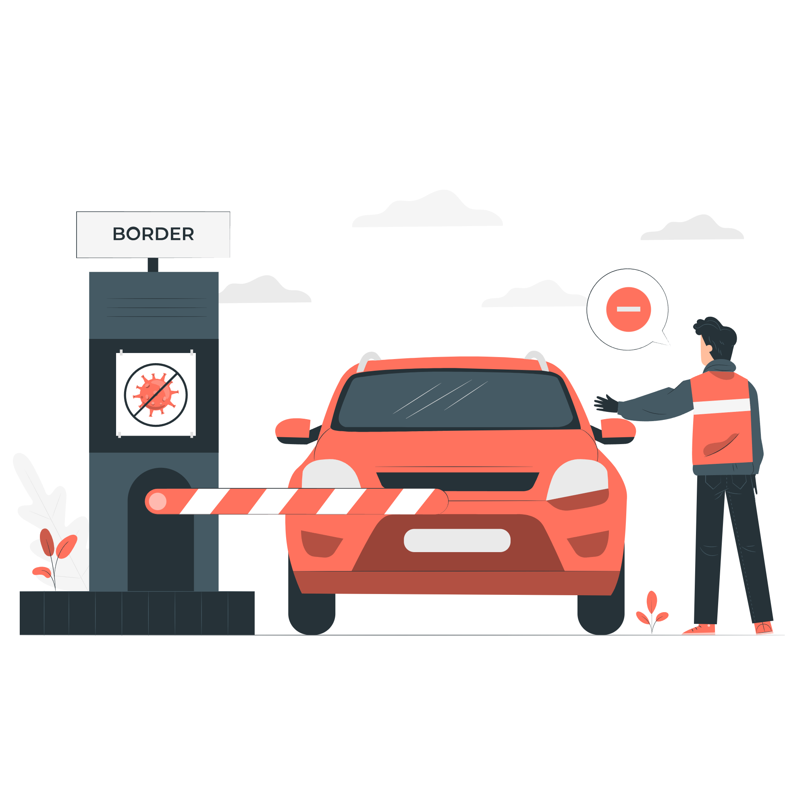
Car Infographic
AiPPT
User groups
32.4%
A well - chosen color scheme can enhance the visual appeal of a car infographic
20XX vs 20XX
Typography plays a vital role in readability

Slide 8
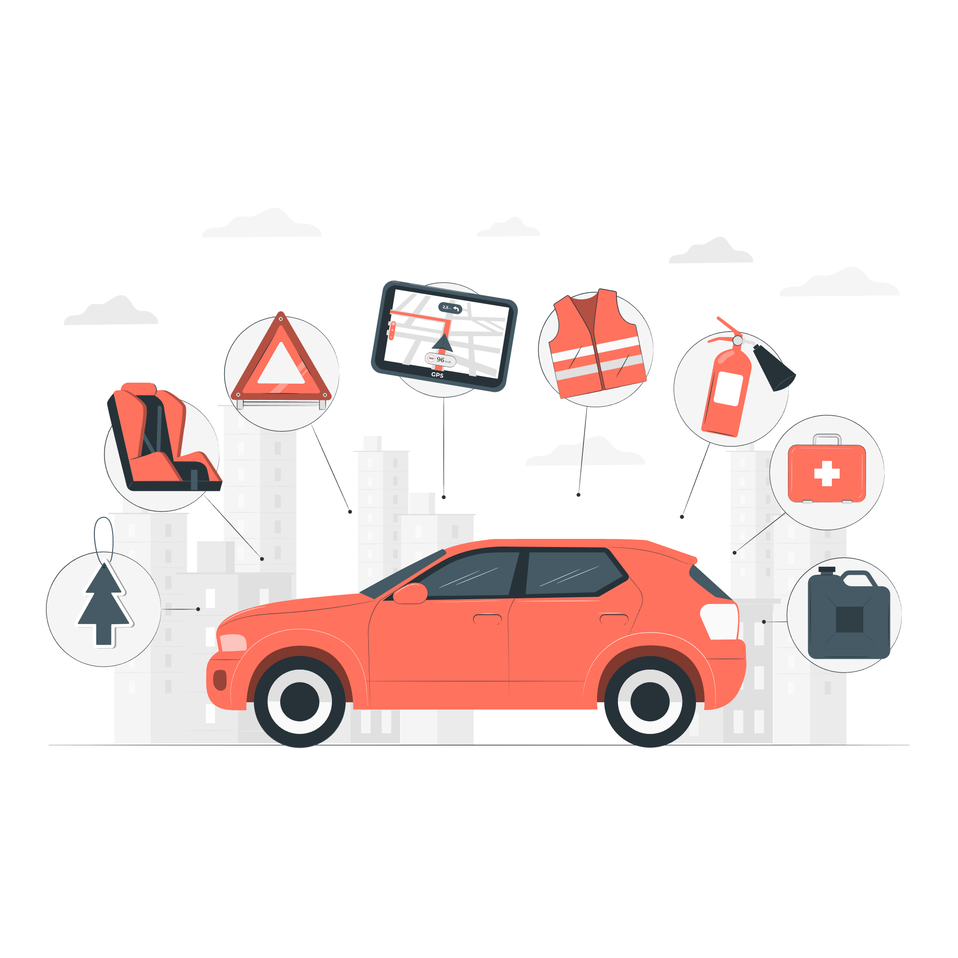
Car Infographic
AiPPT
Engine power
Fuel efficiency
Acceleration
$23.678
$23.6782
$23.6783
$23.6784
$23.6785
$23.67852
$23.67853

Slide 9
Car Infographic
AiPPT
Airbag systems
Collision avoidance
Driver assistance
Seatbelt technology
Airbag systems are designed to protect passengers in the event of a collision.
Crash test ratings are assigned based on a car's performance in various crash scenarios
Collision avoidance technologies use sensors and cameras to detect potential crashes.
Driver assistance features, such as lane - keeping assist and adaptive cruise control

Slide 10

Car Infographic
AiPPT
Data collection
Design selection
Visualization tools
Gather data from various sources such as manufacturer specs, market research, and consumer surveys to ensure comprehensive
Choose a design style that aligns with the purpose of the infographic. Consider factors like color scheme, typography
Employ appropriate visualization tools like Adobe Illustrator or Canva to transform the data into engaging visual elements

